Slide 1
Universal Acceptance of Domain Names and Email Addresses
UA Day Program
DD Month 2024

Slide 2
Agenda
Introduction
Overview of Universal Acceptance
Fundamentals of Unicode
Fundamentals for IDNs
Fundamentals for EAI
Conclusion

Slide 3
Overview of Universal Acceptance (UA)

Slide 4
Universal Acceptance of Domain Names and Email
Goal
All domain names and email addresses work in all software applications.
Impact
Promote consumer choice, improve competition, and provide broader access to end users.

Slide 5
Categories of Domain Names and Email Addresses
It’s now possible to have domain names and email addresses in local languages using UTF8
Internationalized Domain Names (IDNs)
Email Address Internationalization (EAI)
Domain names
Newer top-level domain names: example.sky
Longer top-level domain names: example.abudhabi
Internationalized Domain Names: 普遍接受-测试.世界
Internationalized email addresses (EAI)
ASCII@IDN marc@société.org
UTF8@ASCII ईमेल@example.com
UTF8@IDN 测试@普遍接受-测试.世界
UTF8@IDN; right-to-left scripts موقع.مثال@میل-ای

Slide 6
Scope of UA Readiness for Programmers
Support all Domain Names including Internationalized Domain Names (IDNs) and all Email Addresses, including Internationalized Email Addresses (EAI):
Accept: The user can input characters from their local script into a text field
Validate: The software accepts the characters and recognizes them as valid
Process: The system performs operations with the characters
Store: The database can store the text without breaking or corrupting
Display: When fetched from the database, the information is correctly shown
Accept
Validate
Process
Store
Display

Slide 7
Technology Stack for UA Consideration
Applications and Websites
- Wikipedia.org, ICANN.org, Amazon.com, custom websites globally
- PowerPoint, Google-Docs, Safari, Acrobat, custom apps
Programming Languages and Frameworks
- JavaScript, Java, Swift, C#, PHP, Python
- Angular, Spring, .NET core, J2EE, WordPress, SAP, Oracle
Standards and Best Practices
- IETF RFCs, W3C HTML, Unicode CLDR, WHATWG
- Industry-based standards (health, aviation, ...)
Platforms, Operating Systems and Sytem Tools
- iOS, Windows, Linux, Android, App Stores
- Active Directory, OpenLDAP, OpenSSL, Ping, Telnet
Social Media and Search Engines
- Chrome, Bing, Safari, Firefox, local (e.g., Chinese) browsers
- Facebook, Instagram, Twitter, Skype, WeChat, WhatsApp, Viber
Accept, validate, process, store and display
all domain names and email addresses.

Slide 8
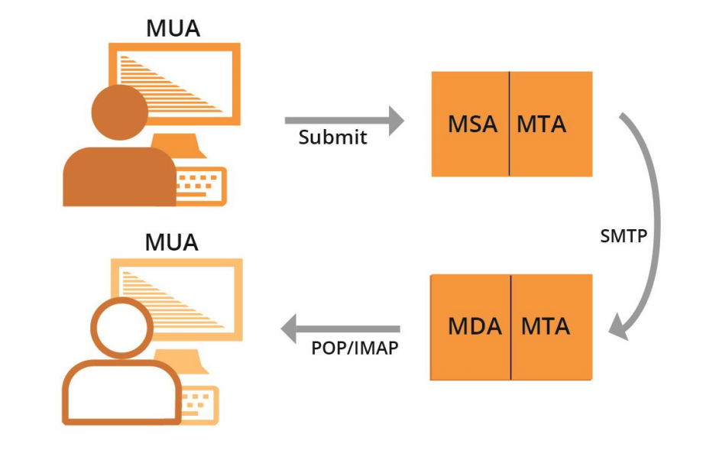
Email Systems and EAI Support
All email agents must be configured to send and receive internationalized email addresses. See EAI: A Technical Overview for details.
MUA – Mail User Agent: A client program that a person uses to send, receive, and manage mail
MSA – Mail Submission Agent: A server program that receives mail from a MUA and prepares it for transmission and delivery
MTA – Mail Transfer Agent: A server program that sends and receives mail to and from other Internet hosts. An MTA may receive mail from an MSA and/or deliver mail to an MDA.
MDA – Mail Delivery Agent: A server program that handles incoming mail and typically stores it in a mailbox or folder

Slide 9
Examples of Email Components
MUA – Mail User Agent – Outlook, Thunderbird, Amazon’s shipping backend, Gmail’s webmail subsystem, a web server’s contact form
MSA – Mail Submission Agent – Exchange, Postfix, Sendgrid, AWS Workmail
MTA – Mail Transfer Agent – Postfix, Exim, Halon, Sendgrid, AWS Workmail
MDA – Mail Delivery Agent – part of Gmail and Exchange, parts of Zendesk
Smartphone MUA app
MTA for recipient
MTA for sender
MSA for sender
MTA: Spam filter
Mail storage
MUA: Webmail

Slide 10
Examples of Email Components
MUA – Mail User Agent – Outlook, Thunderbird, Amazon’s shipping backend, Gmail’s webmail subsystem, a web server’s contact form
MSA – Mail Submission Agent – Exchange, Postfix, Sendgrid, AWS Workmail
MTA – Mail Transfer Agent – Postfix, Exim, Halon, Sendgrid, AWS Workmail
MDA – Mail Delivery Agent – part of Gmail and Exchange, parts of Zendesk
Web browser
Web server
MUA: Contact form software
MTA for recipient
MTA for sender
MSA for sender
MTA: Spam filter
Mail storage
Smartphone MUA app

Slide 11
Fundamentals of Unicode

Slide 12
Character and Character Set
A label or string such as أهلا, नमस्ते, Hello is formed of characters
Hello → H e l l o
A character is unit of information used for the organization, control, or representation of textual data
Examples of character:
Letters
Digits
Special characters, i.e. mathematical symbols, punctuation marks
Control characters - typically not visible
American Standard Code for Information Interchange (ASCII) assigns encodes characters used in computing including letters a-z, digits 0-9 and others

Slide 13
Code Point
Code point is a value, or a position, for a character, in any coded character set
Code point is a number assigned to represent an abstract character in a system for representing text
Notes:
https://bournetocode.com/projects/GCSE_Computing_Fundamentals/pages/3-3-5-ascii.html

Slide 14
Code Point
Code point is a value, or a position, for a character, in any coded character set
Code point is a number assigned to represent an abstract character in a system for representing text
Notes:
https://bournetocode.com/projects/GCSE_Computing_Fundamentals/pages/3-3-5-ascii.html

Slide 15
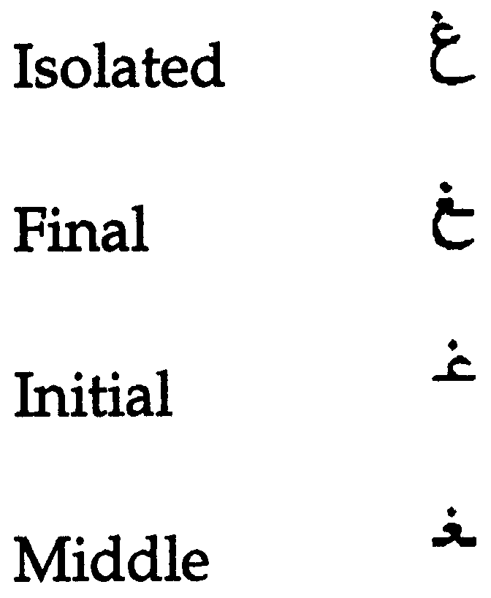
Glyph
A typographic representation of a character is called a glyph
English: a, a
Each Arabic letters often have four glyphs based on where they occur in a string. For example, for the ARABIC LETTER GHAIN the four glyphs are:
Languages may be written/displayed in right-to-left and left-to-right order but reading of data is on the basis of key press order in a file and not dependent on writing direction

Slide 16
Character Encoding
Character encoding is mapping from a character set definition to the actual code units used to represent the data
An encoding describes how to encode code points to bytes and how to decode bytes to code points

Slide 17
A Brief History
Basic ASCII single 7-bit character, limited to a maximum of 128 characters
Extended ASCII single 8-bit character, limited to a maximum limit of 256 characters
ASCII encoding could contain enough characters to cover all the languages
So, different encoding systems were developed for assigning numbers to characters for different languages and scripts, which created interoperability problems

Slide 18
Unicode Standard
The standard for digital representation of the characters used in writing all of the world's languages
Organized characters at script level
Unicode provides a uniform means for storing, searching, and interchanging text in any language
It is used by all modern computers and is the foundation for processing text on the Internet
Number of slots to represent world languages is 0000 – 10FFFF. See https://unicode.org/charts/ to see script coverage and encoding ranges.

Slide 19
Unicode Encoding
Unicode can be implemented by different character encodings:
UTF-8
UTF-16
UTF-32
UTF-8 encoding is generally used by the Domain Name System (DNS)
UTF-8 is variable length character encoding
UTF-8 encodes code points in one to four bytes, read one byte at a time:
For ASCII characters 1 byte is used
For Arabic characters 2 bytes are used
For Devanagari characters 3 bytes are used
For Chinese characters 4 bytes are used
So, for byte-level reading, we need to specify encoding before file reading

Slide 20
Normalization
There are multiple ways to encode certain glyphs in Unicode:
è = U+00E8
e + ` = è = U+0065 + U+0300
آ = U+0622
ٓ + ا = آ =U+0627 U+0653
The following string can exist in corpus in the form of first string below, whereas input string is in the form of second string, below. So, search result will be empty.
آدم (U+0622 U+062F U+0645)
آدم (U+0627 U+0653 U+062F U+0645)
For searching, sorting and any string operations we need normalization
Normalization ensures that the end representation is the same, even if users type differently

Slide 21
Normalization
Different normalization forms defined by Unicode are listed below:
Normalization Form D (NFD)
Normalization Form C (NFC)
Normalization Form KD (NFKD)
Normalization Form KC (NFKC)
In domain names NFC is used
C is composed (å is one character), while D is decomposed (å is a + ring-above)
K includes additional bug compatibility, and seldom used now

Slide 22
Internationalized Domain Names

Slide 23
Domain Names
A domain name is an ordered set of labels or strings: www.example.co.uk
The top-level domain (TLD) is the rightmost label: ”uk”
Second-level domain: “co”
Third-level domain: “example”
Initially, TLDs were only two or three characters long (e.g., .ca, .com)
Now TLDs can be longer strings (e.g., .info, .google, .engineering)
TLDs delegated in the root zone can change over time, so a fixed list can get outdated
Each label is 63 octets
Total domain name length can not be more than 255 (including separators)

Slide 24
Internationalized Domain Names (IDNs)
Domain names can also be internationalized when one of the labels contains at least one non-ASCII character
For example: www.exâmple.ca, 普遍接受-测试.世界., صحة.مصر, ทัวร์เที่ยวไทย.ไทย
There are two equivalent forms of IDN domain labels: U-label and A-label
Human users use the IDN version called U-label (using UTF-8 format): exâmple
DNS uses an ASCII equivalent called A-label:
Take user input and normalize and check against IDNA2008 to form IDN U-label
Convert U-label to punycode (using RFC3492)
Add the “xn--” prefix to identify the ASCII string as an IDN A-label
exâmple => exmple-xta => xn--exmple-xta
普遍接受-测试 => --f38am99bqvcd5liy1cxsg => xn----f38am99bqvcd5liy1cxsg
Most systems should use U-labels, particularly databases

Slide 25
Email Address Internationalization (EAI)

Slide 26
Email Address
Email address syntax: mailboxName@domainName
Email has a mailboxName
Email has a domainName
The domainName can be ASCII or IDN
For example:
myname@example.org
myname@xn--exmple-xta.ca
myname@exâmple.ca
If you receive email from others, then you will see both …@exâmple... and …@xn--example-xta… in use
The former is more commonly used
exâmple@xn--example--xte... is valid and used, but xn--…@xn--… is not valid

Slide 27
EAI
EAI has the mailboxName in Unicode (in UTF-8 format)
The domainName can be ASCII or IDN
For example:
kévin@example.org
すし@ xn--exmple-xta.ca
すし@快手.游戏.

Slide 28
Email Addresses Form
name@exâmple.ca and name@xn--exmple-xta.ca represent equivalent email addresses
Application should be able to treat both forms as equivalent
Internally consistently use A-label or U-label, but don’t mix A-label and U-label
Technical recommendation: Backend processing should use:
A-label for software that uses the DNS or SMTP byte-level protocol
U-label for most software (e.g. normal django/flask/rails/symfony applications)
Check that input works using both formats (or even mixed format)

Slide 29
Sending and Receiving
We need to be able to send to either form:
mailboxName-UTF-8@A-labelform
mailboxName-UTF-8@U-labelform
We need to be able to receive from either form:
mailboxName-UTF-8@A-labelform
mailboxName-UTF-8@U-labelform
Storage of email should be consistent with domain name in either A-label or U-label form
Backend send/receive should be managed by mail server
Handover process (Front end application → email server)
Libraries used in handover process should be EAI compliant
Mail server should also be EAI compatible
How to make mail server EAI compatible is out of scope of this training

Slide 30
Conclusion

Slide 31
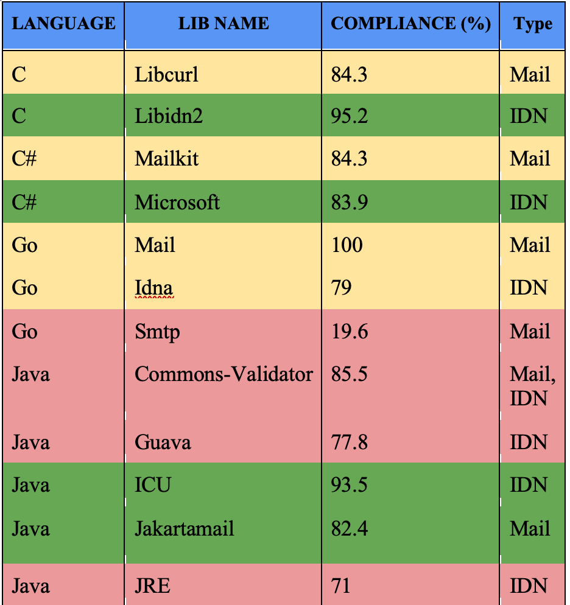
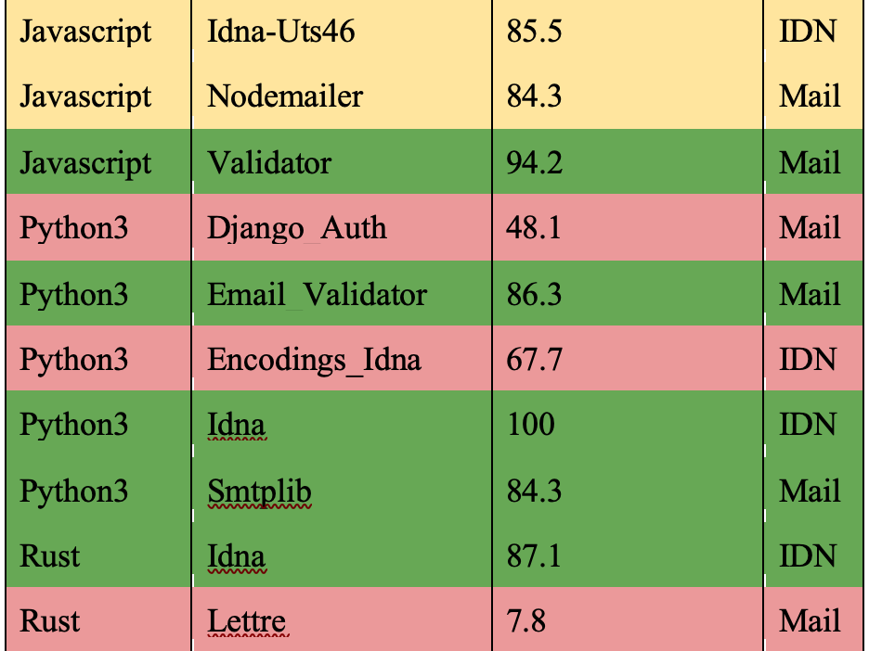
Prog. Languages Support
UASG018A

Slide 32
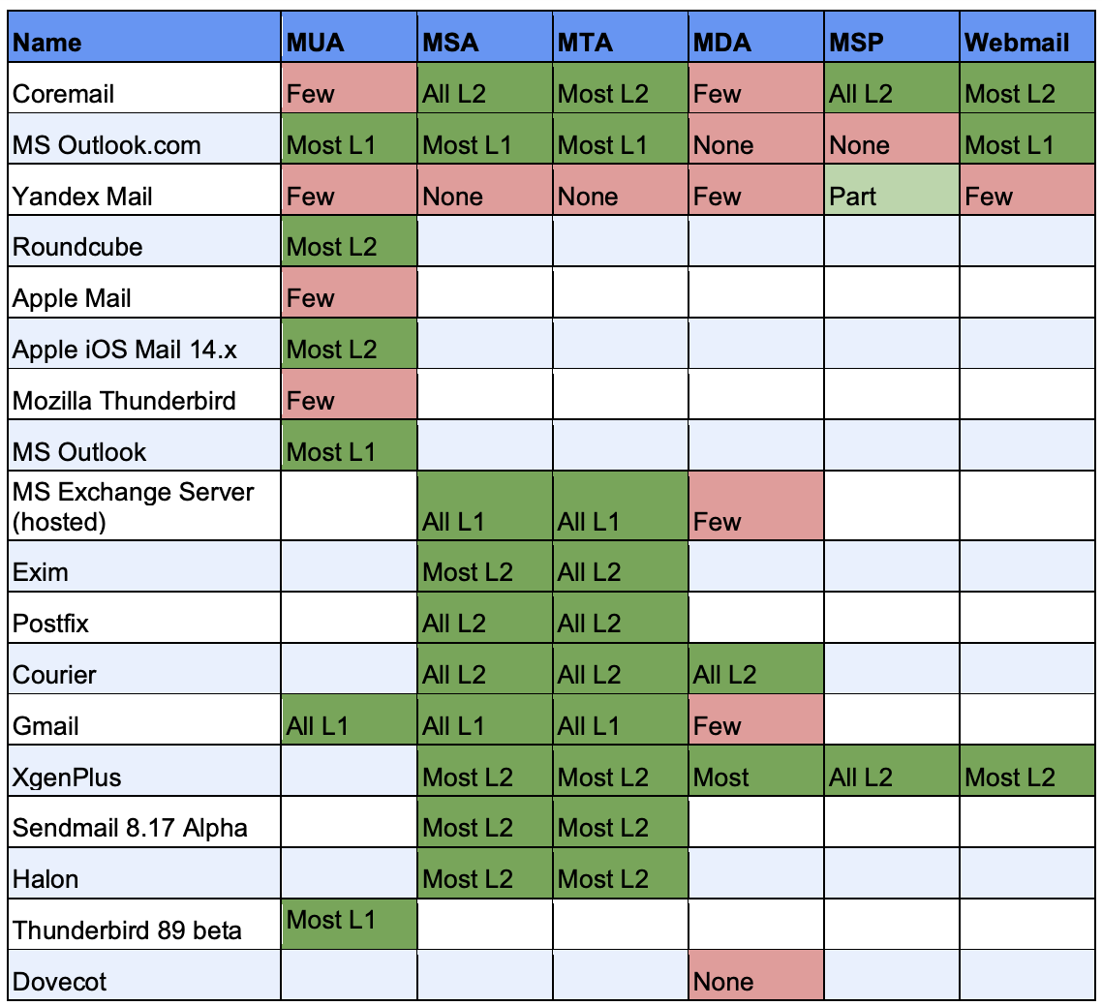
EAI Support by Email Tools and Services
See detailed testing results in UASG030A: EAI Software Test Results

Slide 33
ICANN’s Journey to UA Readiness - Model
Stage 1: Update services to support both new short and long ASCII TLDs
Stage 2: Update services to support non-ASCII Internationalized Domain Names (IDNs) in Unicode (U-label), and ASCII-based IDN representations in Punycode (A-label)
Stage 3: Update infrastructure and services to support non-ASCII email addresses
Note: all components must support Email Address Internationalization (EAI) before infrastructure is compliant
See details in ICANN’s Case Study

Slide 34
Get Involved!
For more information on UA, email info@uasg.tech or UAProgram@icann.org
Access all UASG documents and presentations at https://uasg.tech
Access details of ongoing work from wiki pages: https://community.icann.org/display/TUA
Register to participate or listen in the UA discussion list at https://uasg.tech/subscribe
Register to participate in UA working groups here

Slide 35
Some Relevant Materials
See https://uasg.tech for a complete list of reports
Universal Acceptance Quick Guide: UASG005
Introduction to Universal Acceptance: UASG007
Quick Guide to EAI: UASG014
EAI – A Technical Overview: UASG012
UA Compliance of Some Programming Language Libraries and Frameworks – UASG018A
EAI – Evaluation of Major Email Software and Services: UASG021B
Universal Acceptance Readiness Framework: UASG026
Considerations for Naming Internationalized Email Mailboxes: UASG028
Evaluation of EAI Support in Email Software and Services Report: UASG030
UA of Content Management Systems (CMS) Phase 1 – WordPress: UASG032
The code samples used: https://github.com/icann/ua-code-samples

Slide 36
Engage with ICANN – Thank You and Questions
Email: sarmad.hussain@icann.org

